Slide 1

Securing ebu new operating model through responsibilities clarification & Process excellence
Technical Proposal

Slide 2

AGENDA
Our understanding of requirements
Our Approach
Proposed Team
Why Us
Credentials

Slide 3

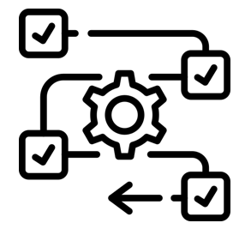

Following a recent reorganization, intends to clarify the teams’ mandates and update processes in its BPM tool, Aris
Our Understanding
Approach
Team
Why US
Credentials
Carried out a reorganization of the enterprise Business Unit at the beginning
Further activities and initiatives remain to be undertaken :
Some roles & responsibilities still need to be clarified & the lower level org structure updated
Some processes need to be aligned with the new model
BPM tool (Aris) has to be updated with new processes documentation

Slide 4
Business mandates of the new organization need to be clarified and processes updated in 2 steps, while ensuring quality
Our Understanding
Approach
Team
Why US
Credentials
PHASE 1: Assessment & Framing
PHASE 2: Process design & validation
eBU New Organization Assessment
Process Implementation Execution & Control:
    Business process implementation plan
    Develop guidelines for communication
    Manage & review business process execution as per Quality Assurance guidelines
“Quality Assurance Approach”
Roles & Responsibilities (Mandates) clarification
Outcome
Updated Organization & Mandates
Documented & Validated Processes in BPMN system (Aris)
Identification of Impacted Processes
1+8 Weeks*
Impacted Business Process Re-design**
    Business Process Design
    Process Validation & Sign-off
    Process update in BPMN system (Aris)
    Change Management
“Process Implementation Approach”
10 Months
12 Months
*The timelines for Organization Assessment are subjected to change based on the EBU sectors in scope (Core & Non-Core)
** Process redesign will be conducted for processes impacted by organizational restructuring

Slide 5
We recommend a two phased approach to ensure successful implementation of the new operating model
Our Understanding
Approach
Team
Why US
Credentials
PHASE 1: Assessment & Framing
PHASE 2: Process Design & Validation
eBU New Organization
Assessment
Mandates
Clarification
Identification of Impacted Processes
Process Validation & Sign off
Change Management
Project & team mobilization
Interview with business units, stakeholders to align on scope & impacts
Assessment of EBU Organization Structure, mandates, existing processes and first identification of improvement for core & non-core areas
Business Process Design
Clarification of mandates regarding redundancies, gaps, and any necessary updates.
Mandates approval from required stakeholders
Workshops with stakeholders to review and align on the ‘To-Be’ business processes.
Sign off on L4 business processes from Process owners & SMEs
Recommendations on change management practices to be followed.
Awareness sessions
Development of communication plan to equip employees about the changed processes.
Process detailing until L4 by leveraging TM Forum’s eTOM framework
Alignment with stc standards and methodologies.
Identification of impacted business processes
Detailed approach for Implementation
Key Activities
Quality Assurance and Control
Establishment of QA guidelines, ARIS nomenclature & process guidelines
Lead standups/weekly meetings, oversee execution of corrective tasks, ensuring adherence to quality standards
Review of business processes workflows ensuring adherence to the requirements
Project Charter
Organization structure and mandates assessment report and improvement plan
Updated mandates’ report with approval from related stakeholders
Process Assessment Synthesis with list of processes to be designed or re-designed
Transformation roadmap
L4 processes designed, validated & signed-off
Change Management Process document
Communication plan for process changes
Deliverables
NOTE: Timelines are subjected to change based on the no. of processes, size and complexity.

Slide 6


The Assessment & Framing phase will enable to update the to-be eBU mandates & related org. structure and scope impacted processes
PHASE 1: Assessment & Framing
Our Understanding
Approach
Team
Why US
Credentials
a
b
c
Organization
Drivers for eBU reorganization
Organization decisions to-date (overall org. structure, lower level status…)
Mandates to be clarified
Modified areas of responsibility?
Potentially-conflicting areas?
Unclear areas/empty spaces?
Clarification of Roles & Responsibilities (mandates)
Understanding of As Is & needs for organizational clarification
For mandates to be clarified
Redefinition/update of Roles & Responsibilities for top-level eBU teams (RACIs)
Organization
Redefinition/update of eBU lower level organizational structure to fit with updated mandates
Update of recommended
lower level org. structure
(if needed)
Organization
RACI Workshops
Interviews
d
Processes impacted regardless of the
pending Roles & Responsibilities clarification
Processes impacted taking into account the changes in the Roles & Responsibilities
Identification of impacted processes
eBU Process update / redesign in the Implementation phase
Processes
Identification of impacted processes

Slide 7
For the assessment & update of activities impacted by the new eBU Organization, we will work on the processes according to the eTOM model
PHASE 1: Assessment & Framing
Our Understanding
Approach
Team
Why US
Credentials
CORE PROCESSES – Frameworx / eTOM based
1
2
Sales & Marketing
Customer Management Layer
ILLUSTRATIVE
P&L Head
Impacting Process Block
6
7
8
3
Product Design & Development
Service Layer
Sales
1
2
3
4
IT Design & Development
Operational Readiness & Service Fulfilment
Service Assurance
Network Layer
Billing
Cost of Goods Sold
6
7
8
5
N/w Design & Development
Supplier Layer
SG&A
4
9
10
SUPPORT PROCESSES
Earning Before Interest Tax Depreciation & Amortization (EBITDA)
9
10
Enterprise Support Functions (HR, Finance etc.)
Supplier/Partner Management

Slide 8
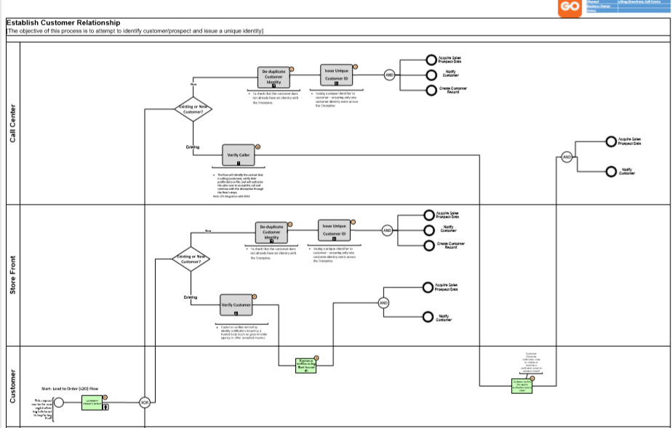
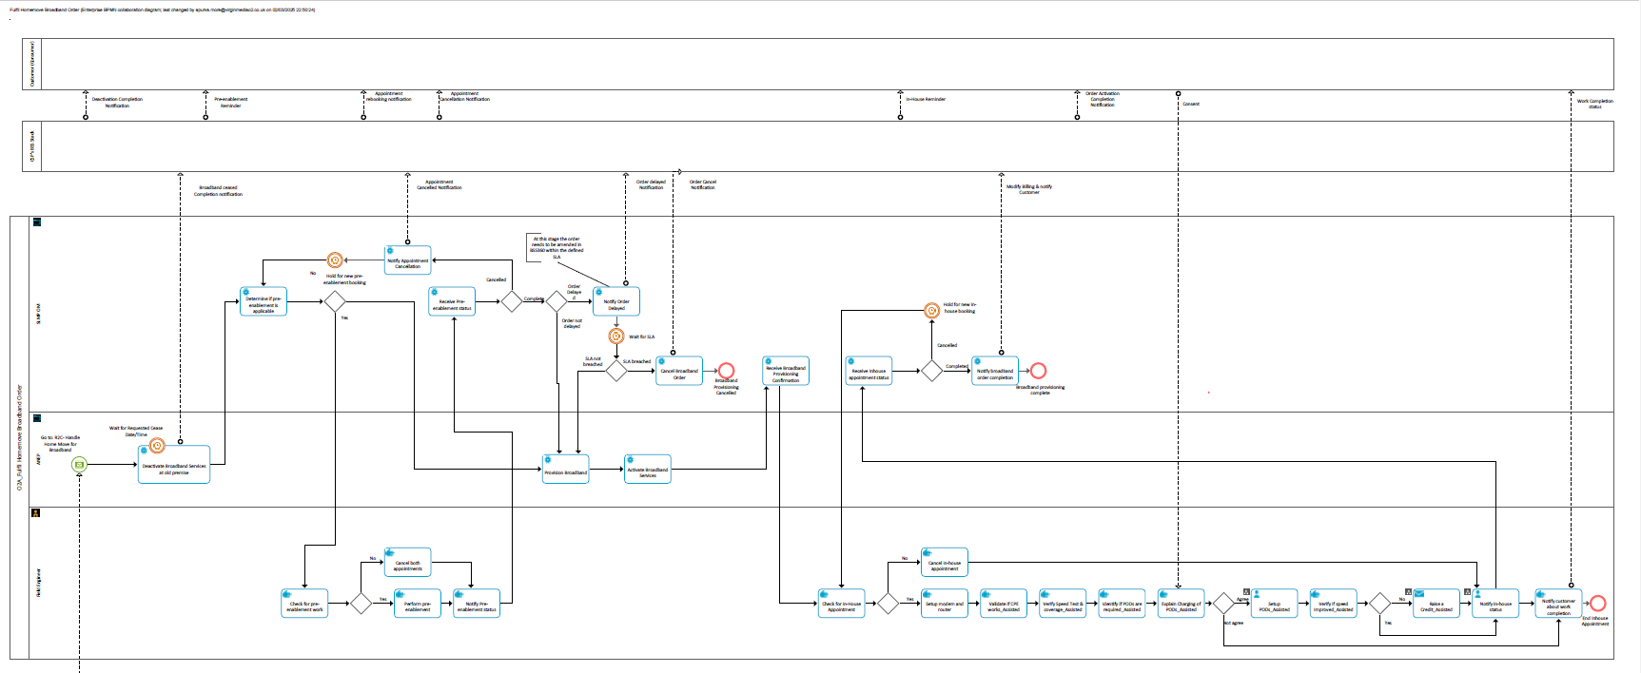
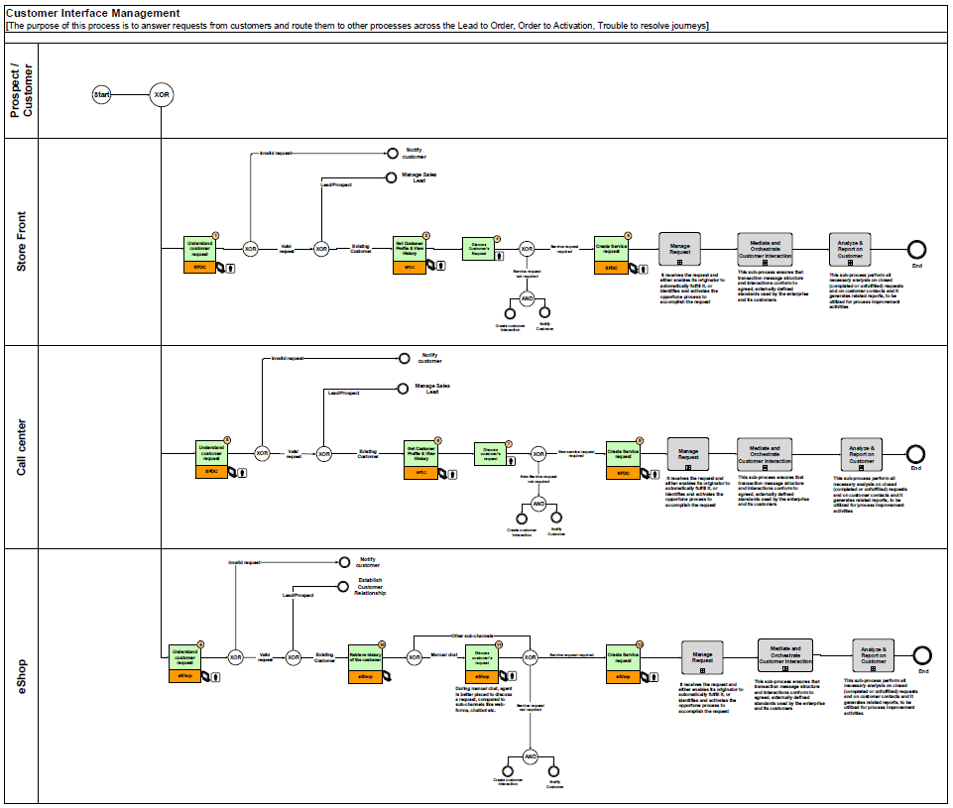
We will apply an agile approach to review and deliver contextualized ‘To-Be’ processes
PHASE 2: Process Design & Validation
Our Understanding
Approach
Team
Why US
Credentials
Lockout & Publish
ILLUSTRATION
Workshop Invite
D0 - 7
Send Draft
D0 - 3
Goal: Contextualized To-Be Process
As-Is Processes
Workshop #1,2,3…n
Conduct Workshop
Management Validation
Day 0
Process Owners Sign -off
Review
D0 + 3
D0 + 4
Telecom Processes
Agile Approach
Contextualized ‘To-Be’ Processes developed in Aris
NOTE: Timelines are illustrative and subjected to change based on the no. of processes, size and complexity.

Slide 9


Our Quality assurance and control team will ensure that the processes are right first time and fit for purpose
PHASE 2: Process Quality Assurance
Our Understanding
Approach
Team
Why US
Credentials
Establish quality objectives and standards
Process implementation execution & Control
Review & Validate
Review and analyze the business processes workflows prepared by Process Implementation Team, to verify if they meet thebusiness requirements, convention and methodology
Perform quality check before BPMN system (Aris) ‘approval’ phase
Establish standards, guidelines and procedures for Quality assurance, Aris nomenclature and process design
Creation of quality management plan to detail the timelines and actions
Identify metrics to measure success
Execute & control business process implementation plan
Lead regular check-ins
Coordinate action items across the process implementation team
Oversee execution of corrective tasks
Ensure adherence to quality standards and project constraints
Middle East team inputs

Slide 10

We will leverage our proven change management methodology to help eBU teams in navigating the process changes
PHASE 2: Change Management
Our Understanding
Approach
Team
Why US
Credentials
GUIDING PRINCIPLES
Build on sponsorship from Executive Leadership to motivate users
Developing a systematic and comprehensive plan to anticipate and address user needs and concerns
Create personas and communication for user awareness
Continuous tracking of change adoption through pre-defined KPIs
MANAGE CHANGE
Change Network
Persona, Communication & Awareness
Hypercare*
Establish and activate Change Agent Network with the team
Set BPMN CoE for optimizing and standardizing business processes.
Capture and share lesson learned
Monitor adoption, resolve issues and enable continuous improvement
Develop user persona to tailor communications
Build and execute target communication through defined channel to create awareness
UNDERSTAND
COMMUNICATE
ADOPT & SUSTAIN*
Users are clear about the purpose and understand its benefits
Users welcome the change and are prepared to use the new processes
Users are happy to adapt to new processes
OUTCOMES
*Hypercare & adoption of Change is not considered in the current project scope.

Slide 11



Capgemini Invent brings the key ingredients for the success of eBU’s Organization & BPM project
Our Understanding
Approach
Team
Why US
Credentials
Expertise in Telco B2B transformation
Organization & Business Process Management
Experienced stc consulting partner
Strong track record of successful transformation projects for international B2B Telecom operators (products, journeys, processes…)
Organizational design expertise, supporting Telecom operators & other industries
Track record of Business Process Management projects @scale
  Business Process optimization & modelling
  Enterprise process redefinition on ERP transformations…
Track record of successful engagements in B2B, B2C, Wholesale & Solutions
Recent projects conducted for eBU included:
IT program management
IT Customer Migration
Product Modelling
B2B Minimum Viable Customer Experience
Middle East team inputs

Slide 12
ILLUSTRATION OF RELEVANT PROJECT CREDENTIALS
Our Understanding
Approach
Team
Why US
Credentials

Slide 13

Capgemini consultants are used to working on target operating models for the foundation of a scalable process excellence
Our Understanding
Approach
Team
Why US
Credentials
  An overarching mission and vision
  Structure and roles
Definition and prioritisation of mid- and long-term goals
Organisational Process Excellence structures and setting the project and business as usual setup (Business + IT), definition of role profiles and assignment of Process Excellence tasks
Mission and vision
Organisation
Structure &
roles
  Qualification and change management
People & culture
Qualification & training
  Policies and committees
Governance
Policies & committees
Change management and communication, qualification concepts and trainings
  Target Operating Model (TOM)
Policies, approval levels, governance bodies and escalation paths, Process Excellence standards for development, compliance / segregation of duties etc.
  Build and run integration
Processes
Build & run integration
Technology
Architecture &
ecosystem
  Architecture and ecosystem
Agile processes for Process Excellence projects and business as usual setup (qualify & build, maintenance, support, administration and management)
Process Excellence software provider architecture and embedding it into the IT ecosystem, data management and infrastructure
Cookbooks available:
Stand-alone Process Excellence or
Synergetic to Process Mining, Automation and AI

Slide 14


For a leading German Telecom operator, we are leveraging strategic BPM, driving the future of telco business process management
Our Understanding
Approach
Team
Why US
Credentials
In Q1 2025, Capgemini Invent was awarded as strategic partner for the BPM strategy in the operator central Transformation program
Business Process Management Strategy & Roadmap design together with CxOs
Selected PoC case with client’s OmniChannel Consumer team to demonstrate process optimization value to the organization
Enabling process mining on the Telco new process management platform (Signavio)
Project embedded as key enabler into client’s central Transformation program
BPM project as key enabler for large Transformation program
Team on the ground combining Telco- and BPM-Know-how

Slide 15




Our Understanding
Approach
Team
Why US
Credentials
We have assisted a Southeast Asian operator in reorganizing their organizational structure and centralizing various business functions to eliminate siloed operations
Business Problem
Solution
Business Benefits
The client's technical services function was distributed across many divisions and departments. Over time, several 'Shadow' IT functions emerged, where business or digital teams made isolated decisions, including software selections, choosing implementation partners, and then transitioning IT support to ISG.
Lack of alignment in vision, fragmented collaboration, and siloed operations were major causes for concern for OCIO
Restructured organizational structure to ensure transparency among different functions while addressing the need for operational excellence and agility, thereby eliminating siloed operations
Centralized the Architecture & Integration functions and introduced/designed the BRM layer into the IT organization eliminating gaps in technology capability & delivery
Revised RACI to ensure transparency across different functions, bringing structure and clarity to roles across different functions
Better collaboration on project
Easier to cross train on new skills
Increased accountability
Increased Agility and Productivity
Decreases silos with fungible workforce
Better operational synergy with Infrastructure services
Fully Autonomous

Slide 16

Our Understanding
Approach
Team
Why US
Credentials
Supported a major Southeast Asian operator with process transformation and assurance, enhancing efficiency and alignment with strategic goals
Business Problem
Solution
Business Benefits
The business faced challenges with its current processes, which were fragmented and inefficient.
There was a lack of alignment and transparency across various functions, leading to siloed operations and reduced agility.
Performed process prioritization and assessment of 400 processes from 8 streams through a matured process optimization methodology
163 L3 eTOM processes simplified with To-be processes documented as per industry best practices
Developed & implemented portal for Network BU, Facilities BU, and 12 BOTS (Processes)
Implemented a Agile delivery with defined sprints across the project, centralized repository of business stream processes, and change management and production support for smooth transition
Improvement in the process workflows due to streamlining leading to faster and more efficient operations.
Optimized processes ensuring higher quality outputs by minimizing errors and enhancing consistency.
Automated processes leading to consistent and precise execution, reducing the likelihood of errors and improving overall quality.

Slide 17

Our Understanding
Approach
Team
Why US
Credentials
Migrated 400 business processes for various customer’s journeys by utilizing Enterprise Architecture tool for a leading US telecom operator
Business Problem
Solution
Business Benefits
The client wanted to run an enterprise initiative that establishes a community-based approach, framework, standards and tools necessary to perform enterprise business processes.
The ask was to deliver the re-usable library of 400 Business Process Flows for both customer facing and back-office enabling functions using the Enterprise Architecture tool - BizzDesign
As-Is processes were required to be migrated from BusinessOptix to BizzDesign with any enhancements or revisions that may be required.
Created processes and developed workflow diagrams to facilitate end-to-end process ownership for Source to Pay, Order to Cash, Record to Report, Project to Retire, Business process mgmt. and Plan to Deliver areas
Established a common language to ensure consistency and understanding across the organization.
Improved hand-offs and cross-functional collaborations to enhance overall efficiency and teamwork
Enhanced process visibility with a comprehensive view of business processes, enabling better understanding and management of customer journeys.
Improved efficiency by streamlining and optimizing processes
Better alignment with business goals and effective decision-making.

Slide 18

Our Understanding
Approach
Team
Why US
Credentials
Assisted a leading Telco operator in India with migrating processes as part of their digital transformation strategy
Business Problem
Solution
Business Benefits
As part of its digital transformation strategy, the business entered a strategic partnership with SAP to simplify IT and business operations through a scalable, cloud-based platform.
This partnership required migrating all processes from ARIS to SAP Signavio
Enabled migration 13000+ global processes, ensuring accurate user details and seamless email replacements within ARIS.
Facilitated the integration between ARIS and SAP Signavio and converted ARIS-based Event Driven Process Chain (EPC) models to BPMN 2.0 post migration.
Addressed the specific needs of various business areas, including Financial Management, Supply Chain Management, Technology Solutions, Central Service Design, and Bid Management over various markets.
Streamlined operations with SAP’s Business Process Transformation Suite as a unified platform by integrating process mining, management and automation into a single platform.
Accelerators: The plug-and-play capability allowing businesses to quickly gain comprehensive 360-degree insights into their processes, facilitating swift identification of bottlenecks and improvement opportunities.
Ability to process data from both SAP and non- SAP systems ensuring a holistic view of business operations, leading to informed decision making.

Slide 19

Our Understanding
Approach
Team
Why US
Credentials
Designed an IT organization structure and operating model
for a large public sector bank in India
Business Problem
Solution
Business Benefits
  Understand current organization structure of the of the three Banks and suggest consolidation/ augmentation of the same as required
  Identify points of convergence for the IT departments which can help to identify synergies for the merged entity
  Design the To-Be Organization Structure along with the resource capacity plan for the merged entity
  Futuristic IT Organization Structure
  Leveraged the strengths of the individual banks and created points of convergence for the merged entity
  ‘Run-the-Bank’ and ‘Change-the-Bank’ approach helped the bank to improve operational excellence and reduced turnaround time. Resource Capacity Planning
  Rationalized Resource requirements with upskilling/cross-skilling initiatives with 8% reduction in manpower for existing departments
  Identified the organization structure synergies across the three merging banks
  Created a futuristic IT structure based on market trends and best practices
  Highlighted the IT functions where resource optimization was a possibility

Slide 20

Our Understanding
Approach
Team
Why US
Credentials
Optimized HR processes to create unified employee experiences for a Health care client in Germany
Business Problem
Solution
Business Benefits
Scattered HR IT Landscape with distinct user experience per application and highly customized solutions
The current system consists of 550+ legacy systems both local and global included (incl. 100 PY + 50 TM)
Complex project environment due to dependencies and interrelations (e.g. H2R, P58)
Most HR IT systems are currently operated by Parent company
Cloud & platform strategy: Leveraging strategic platforms (e.g. Workday, ServiceNow)
Digital User Experience: single engaging global platform as entry point for all users to HR services to enable mobile experiences
Fight complexity with simplicity: to design E2E HR IT processes and focus on strategic platforms with standard integrations
Increase of automation: to ensure operational excellence and free up time of HR to support the business
Data as an asset: actively manage data to ensure compliant and value adding business insights
  Workday as leading system: moving from a heterogenous to a more centralized landscape
  Service Now as single engagement layer platform
  Global Process Standards + Reduction of local systems: Simplified legacy policies and procedures
  Viable approach and lessons learned from Various HR Transformation and HR IT implementation projects

